Slide 1
A somewhat brief introduction to Machine Learning

Slide 2
What is Machine Learning?
Applying statistical learning techniques to automatically identify patterns in data. These techniques can be used to make highly accurate predictions.
As an illustration we’ll be using a data set about homes, we will create a machine learning model to distinguish homes in New York from homes in San Francisco.
This problem in Machine Learning parlance is called “classification”

Slide 3
Is the property in NY vs SFO?
What are some ways to determine whether a home is in New York city or San Francisco?
Square Footage
Price per Square Foot
Year Built
Number of Bathrooms
Number of Bedrooms
Total Rooms

Slide 4
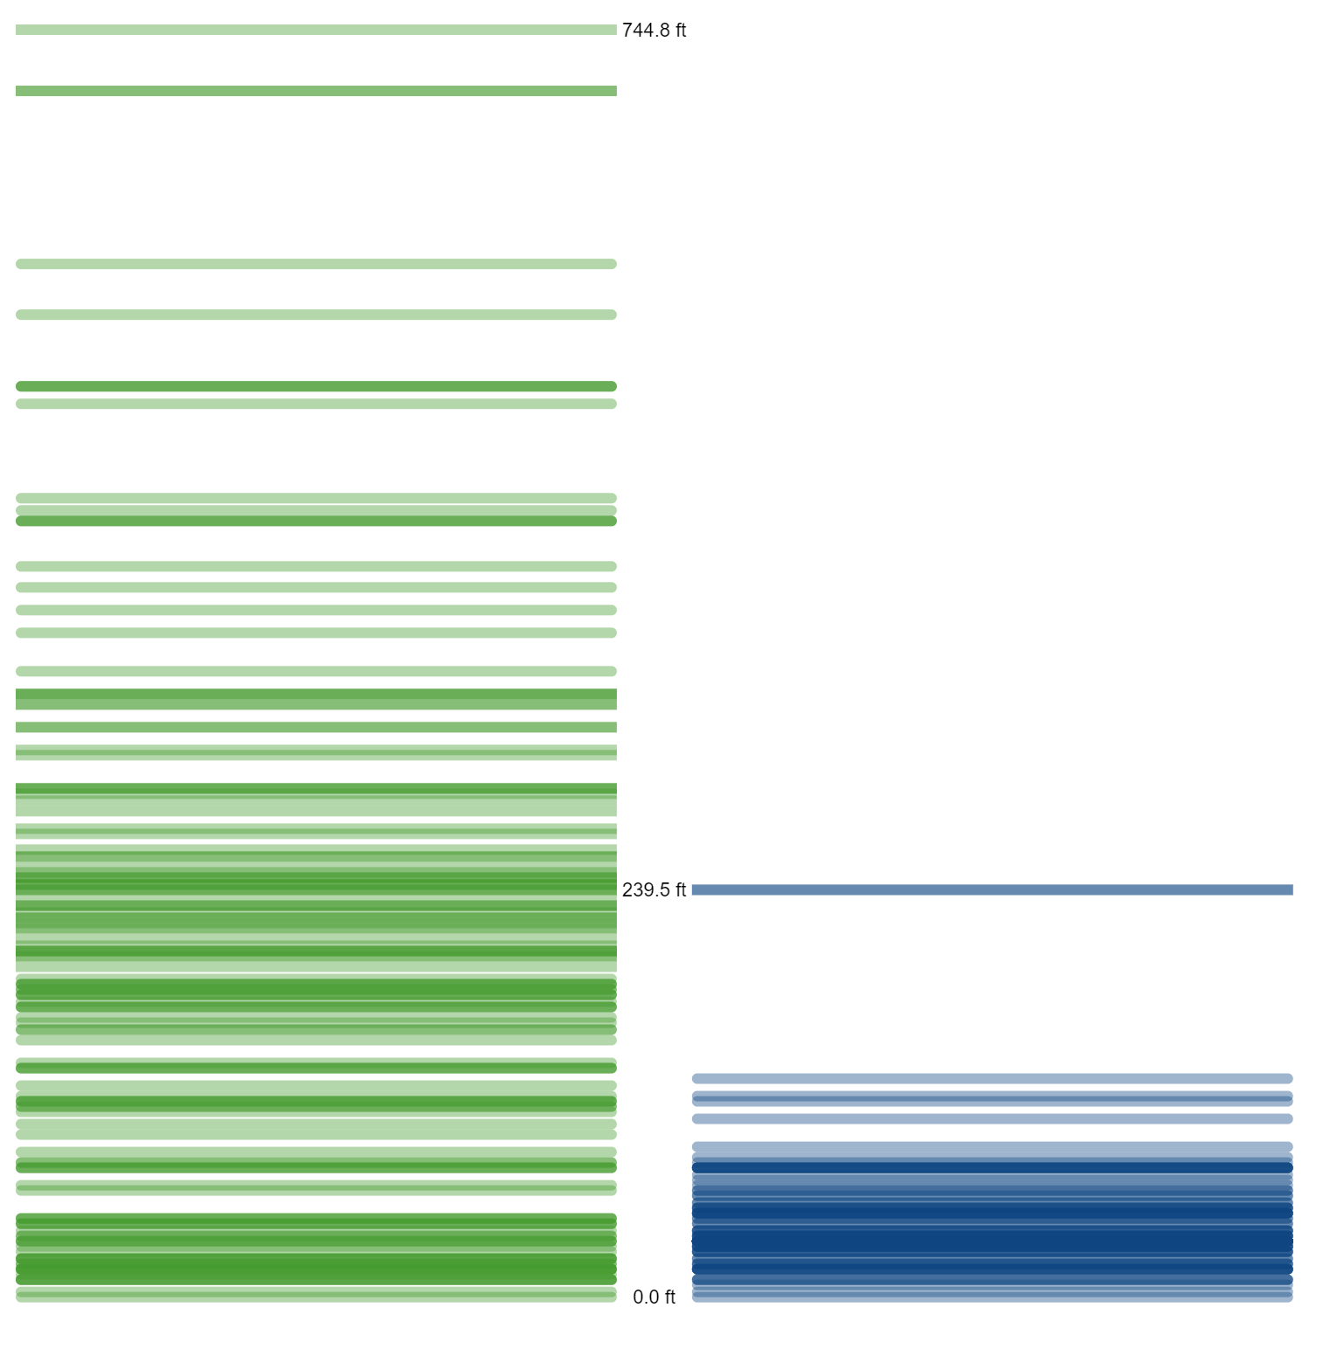
Using intuition
One potential feature we hadn’t discussed is elevation.
San Francisco is relatively hilly, where New York is not. The elevation of a home may distinguish between the two cities.
Based on the home-elevation data to the right, you could argue that a home above 239’ should be classified as one in San Francisco.

Slide 5
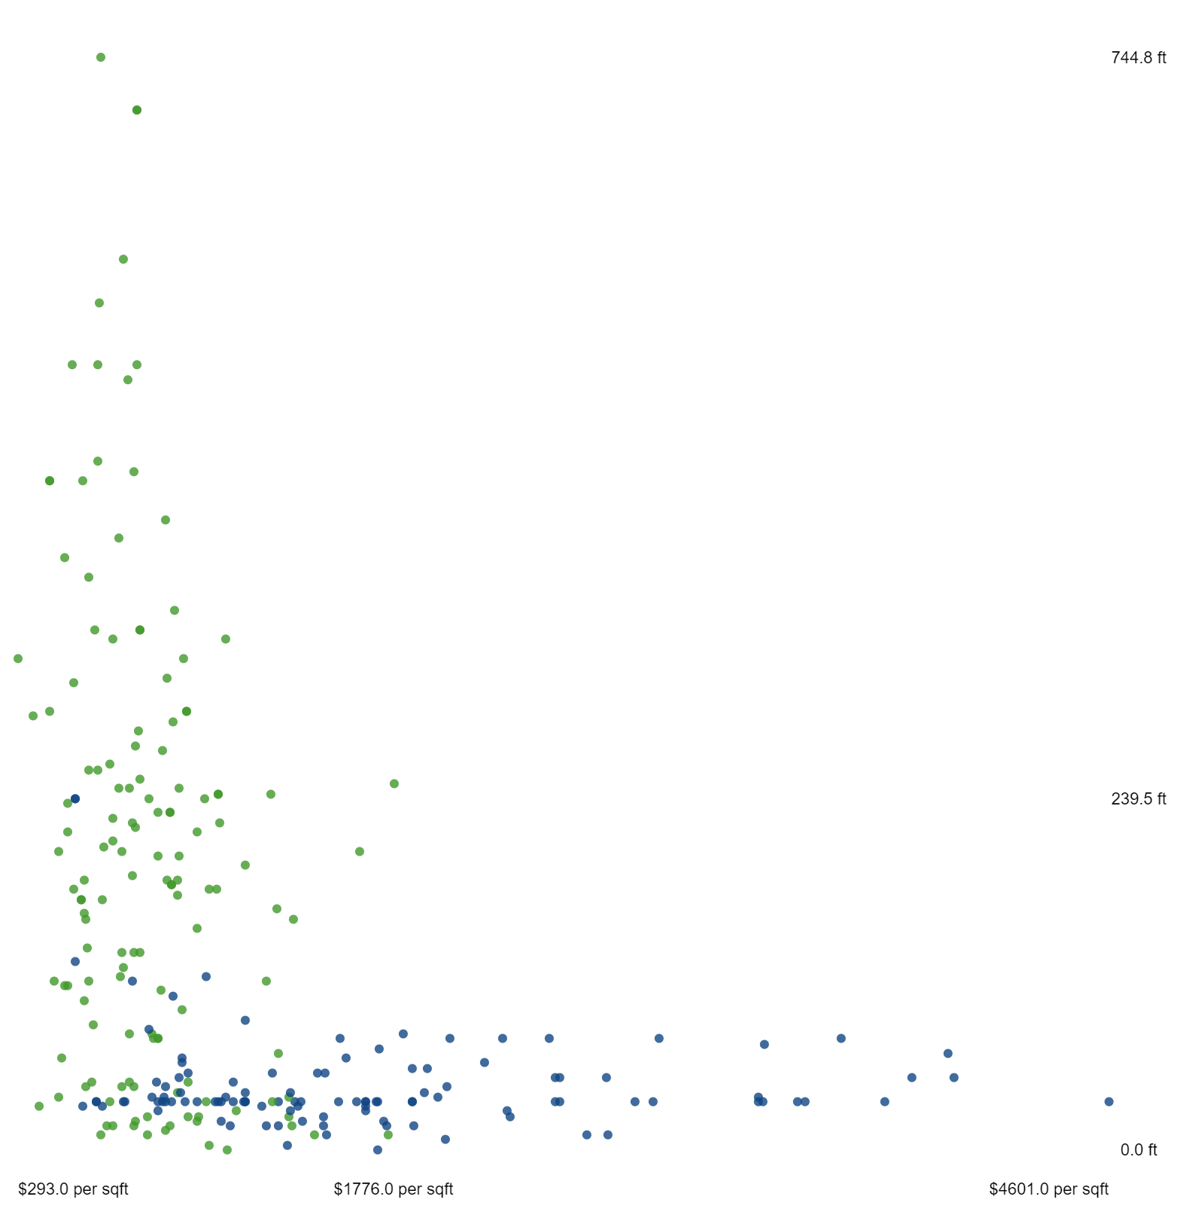
Adding features
Adding another dimension allows for more insights. For example, New York apartments can be extremely expensive per square foot.
Elevation and price per square foot in a scatterplot helps us distinguish lower-elevation homes that we didn’t see with just elevation.
The data suggests that, among homes at or below 239ft, those that cost more than $19,116.7 per square ft are in New York City.

Slide 6
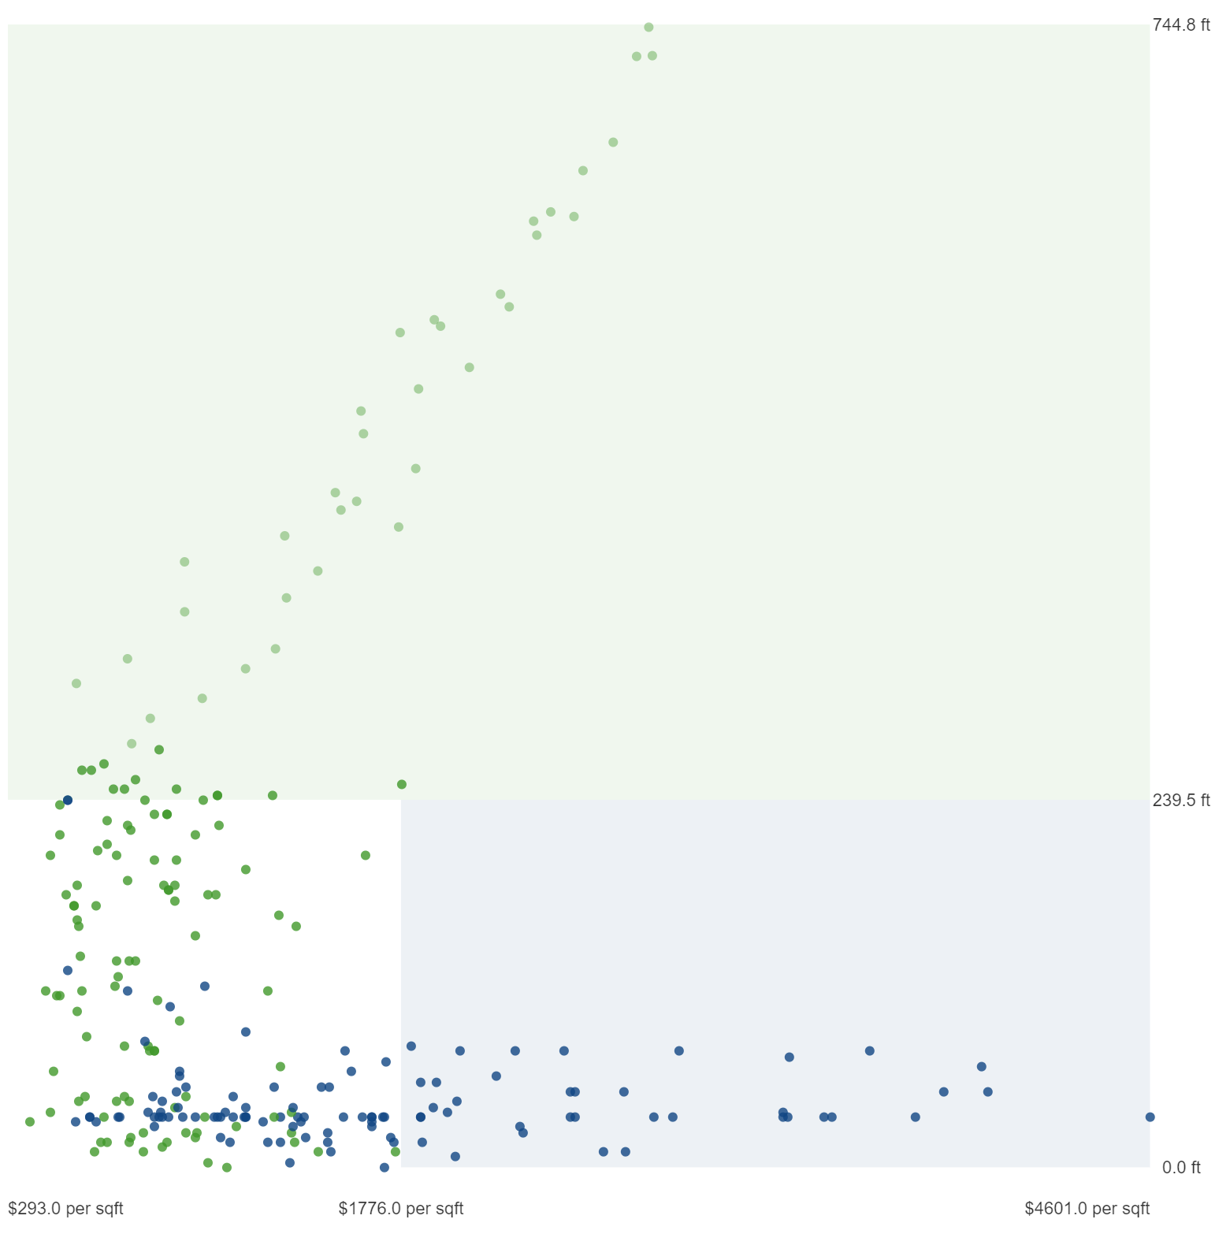
Drawing Boundaries
Visualizing elevation (> 239’) and price per square foot (>$19,116.7) observations as the boundaries of regions in your scatterplot.
Identifying boundaries in data using math is the essence of statistical learning.
We need additional information/features to distinguish homes with lower elevations and lower per-square-foot prices.

Slide 7
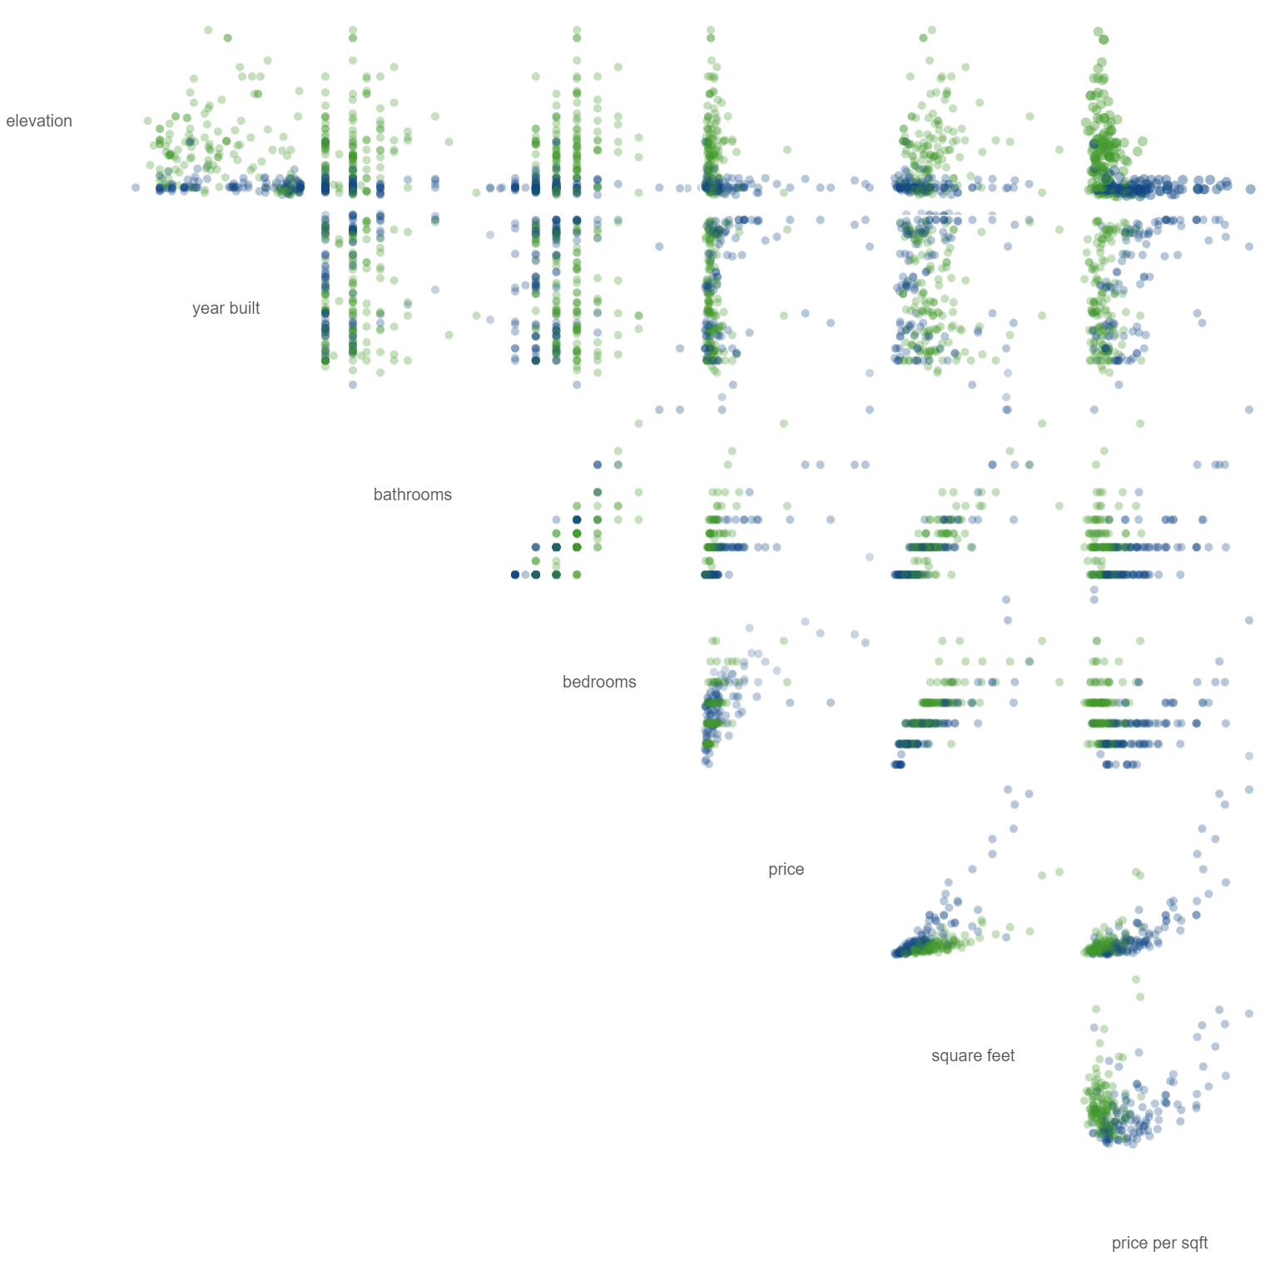
More variables
The dataset we are using to create the model has 7 different dimensions. Creating a model is also known as training a model.
On the right, we are visualizing the variables in a scatterplot matrix to show the relationships between each pair of dimensions.
There are clearly patterns in the data, but the boundaries for delineating them are not obvious.

Slide 8
Now Machine Learning
Finding patterns in data is where machine learning comes in. Machine learning methods use statistical learning to identify boundaries.
One example of a machine learning method is a decision tree. Decision trees look at one variable at a time and are an easy to understand (though rudimentary) machine learning method.

Slide 9
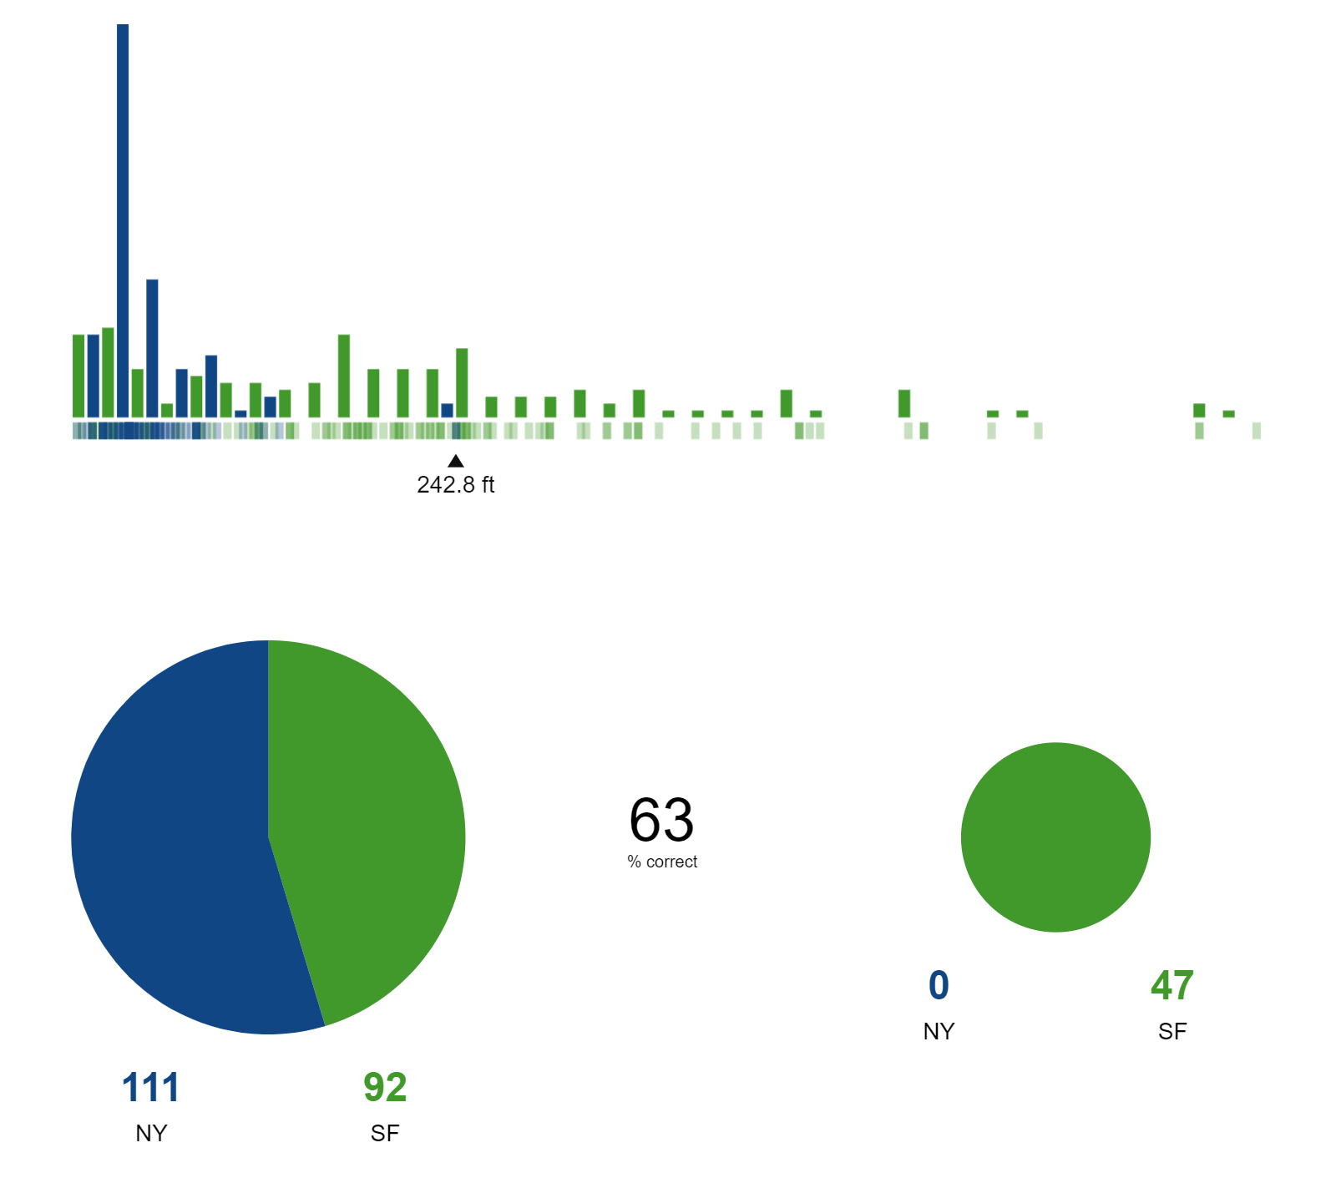
Finding better boundaries
A decision tree uses if-then statements to define patterns in data.
Is 239’ the best boundary to split data?
The goal is to find the best point to split the data which will be become if/then statements that fork the data.

Slide 10
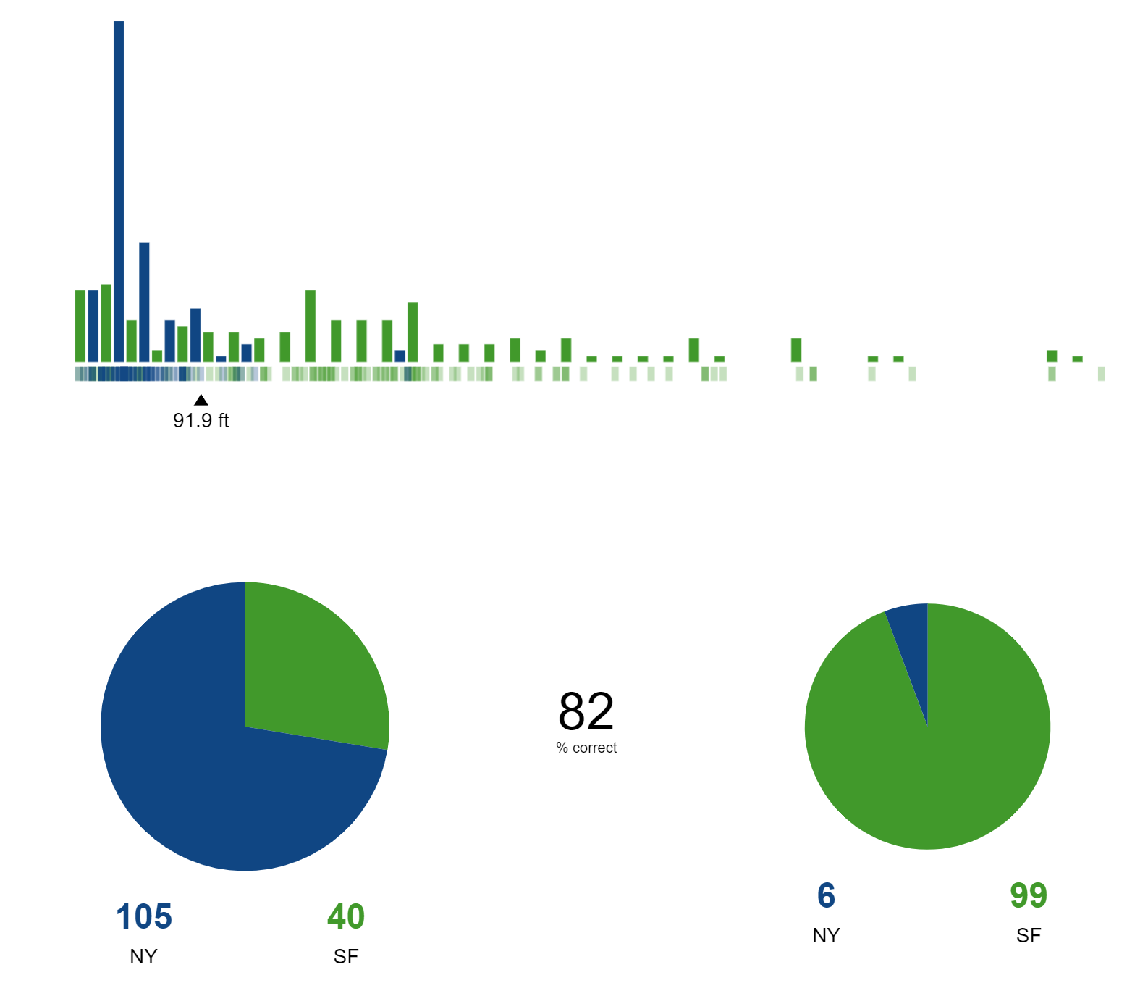
Tradeoffs
In the prior split there were many false negatives.
A split point meant to capture every San Francisco home will include many New York homes as these are called false positives.
The best split, the results of each branch should be as homogeneous (or pure) as possible.

Slide 11
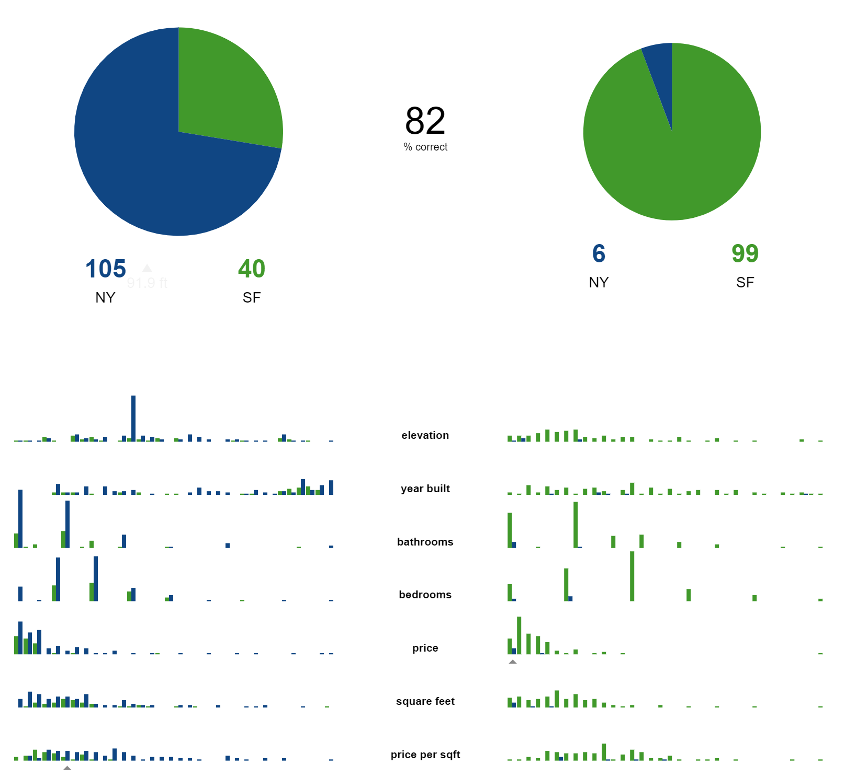
Tree induction
In most models a single feature is insufficient to correctly classify every home.
We must do this repetitively through each fork of the dataset building a tree of feature splits.
The best feature and split will vary based on the data.

Slide 12
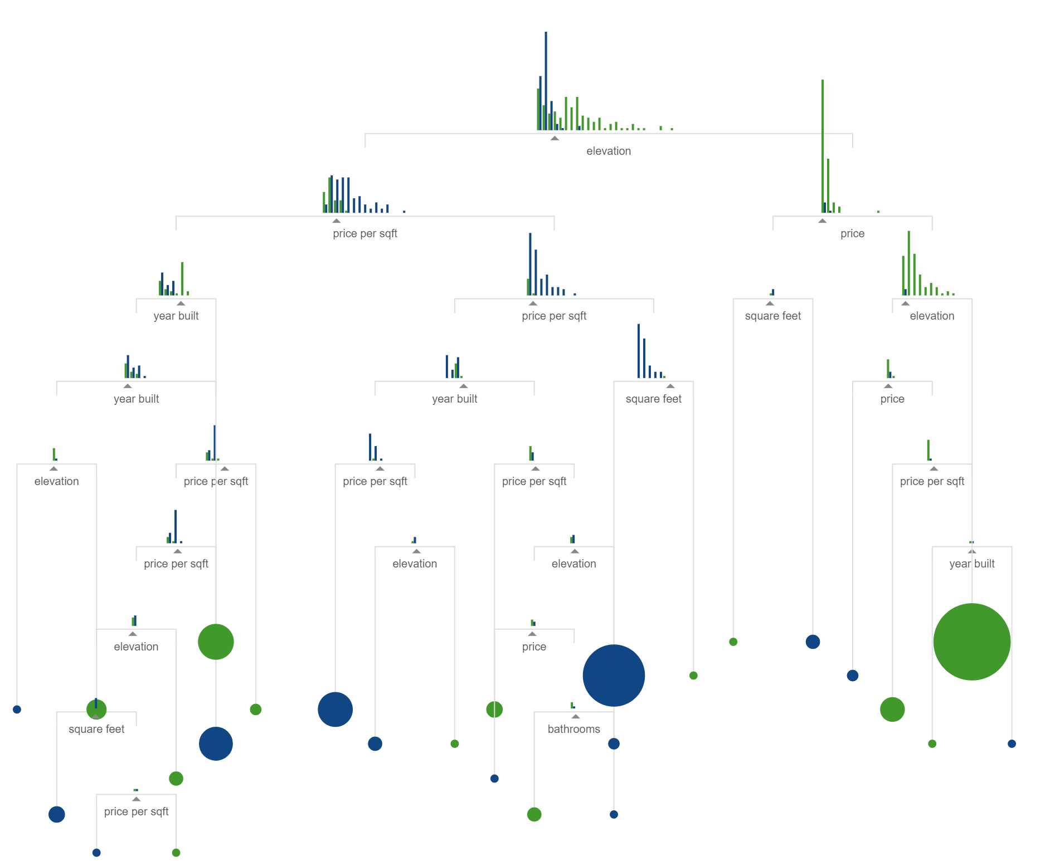
Growing a tree
The process of recursively building features splits in the data builds a tree. Additional forks will add new information that can increase a tree's prediction accuracy.
Adding one layer increases performance from 82 – 84%
Adding several more layers, we get to 96% and beyond.

Slide 13
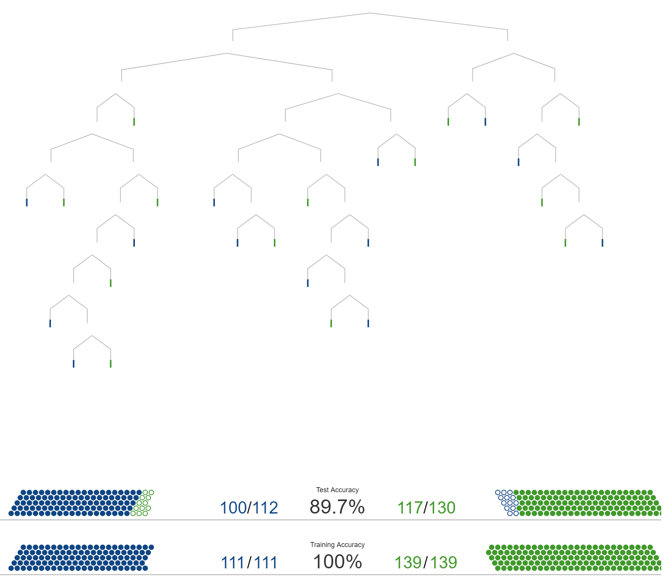
Making predictions
With the trained model, each data point can be examined to determine what class it belongs to.
When compared to testing data held back from training the results are less than ideal. The trained model fits the data too perfectly. This problem is called overfitting.
An ideal model would fit the test data as well as it fits the training data. This is called generalization

Slide 14
Additional concepts in Machine Learning
Input data quality is important
Evolving data can change the performance of your model. This is referred to as “drift”
Trees are not the only type of machine learning model.

